Slide 1
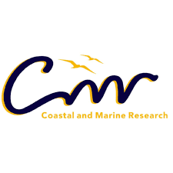
Legislating marine intangible cultural heritage in south africa
Prof Rose Boswell (PhD)
Rose.Boswell@mandela.ac.za
Https://och.mandela.ac.za

Slide 2
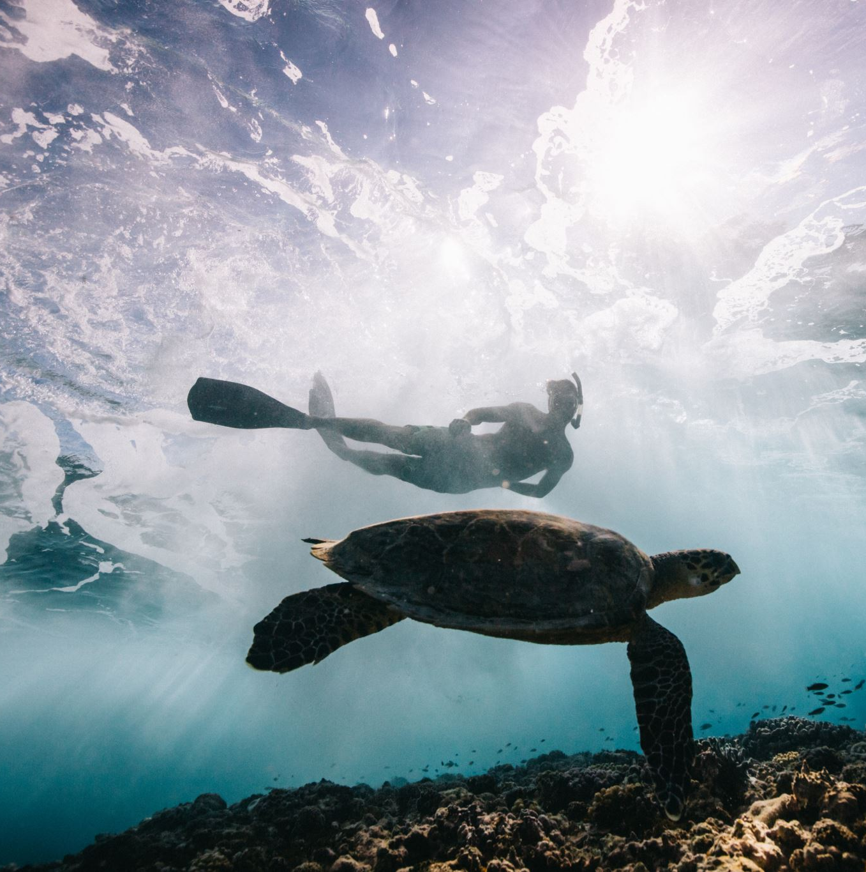
Overview
This presentation proposes that the National Heritage Resources Act 25 of 1999 insufficiently provides for the recognition and protection of marine intangible cultural heritage (MICH) in South Africa.
To facilitate the discussion, two other laws (the National Environmental Management: Protected Areas Act 57 of 2003 and the National Environmental Management: Integrated Coastal Management Act 2008) and various international agreements are considered.
The presentation also considers the relevance of Intangible Cultural Heritage (ICH) to inclusive and ethical development and the role of ICH in coastal development and management, and the role of heritage in South Africa

Slide 3
Critical heritage studies
In recent decades, critical heritage studies propose that heritage conservation is politicised, unequal and risks ossifying culture rather than maintaining its dynamism. Despite these critiques, heritage conservation remains a compelling proposition for nation states and their inhabitants, as it endorses a human rights based approach to development, a globally accepted route for the conservation of socially meaningful public sites, memories and legacies.

Slide 4
Some theoretical & ethnographic frames
World Heritage Sites, WHL, Oral and Intangible Cultural Heritages
Heritage as legacy, metacultural product, Heritage as service, Heritage as symbol of power, between TH and ICH
Heritages of the ‘Other’, Heritage as colonisation, heritage and IKS
Heritage as human right, heritage for inclusion, ethical development, equality
Marine Heritage, Marine cultural heritage, underwater cultural heritage
Heritage Regime
Historical views of Heritage
Politics of Heritage
Heritage in Development
Heritage in marine and maritime sphere

Slide 5
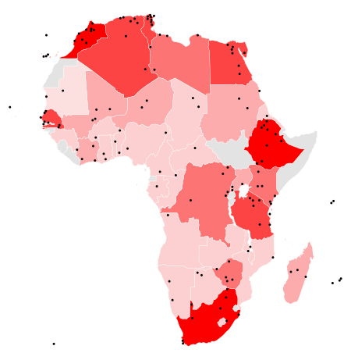
In Africa? 145 sites 39 in danger 50 World Marine Heritage Sites, 2 in Africa no MICH

Slide 7
Key arguments
In the context of coastal resources management, government has passed several laws, three of which are considered in this article. The argument is that these laws do not recognise or protect marine intangible cultural heritage and this has implications for inclusive and democratic coastal management.
The laws are:
the National Heritage Resources Act 25 of 1999 (NHRA),
the National Environmental Management: Protected Areas Act 57 of 2003 and the National Environmental Management: Integrated Coastal Management Act of 2008 (ICM).

Slide 8
International conventions & declarations
South Africa is signatory to several international conventions regarding heritage and rights of indigenous peoples. It also recognizes the UN Decade of Ocean Science for Sustainable Development (2021-2030).
In the latter, the UN calls for improvements to oceans health and an inclusive approach to achieving oceans sustainability.
Both the declarations and conventions signed, produce particular obligations for the South African government, part of which includes necessary legal reforms that deepen inclusion.

Slide 9
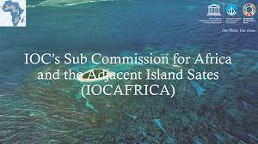
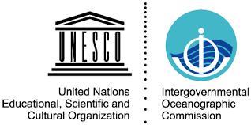
African commitments
At the continental level and to fully realise the aims of the World Heritage Convention, South Africa is part of the UNESCO IOC sub-commission for Africa and Adjacent Island States(IOCAFRICA). It has thus “accepted” the IOCAFRICA strategic plan (2014-2021)
…As a member of IOCAFRICA, South Africa would have taken note of the sub-commission’s comments on the dangers of loss/modification of ecosystems, the over-exploitation of resources and the use of destructive fishing practices. The country would be further aware of its responsibilities towards oceans conservation as noted by the sub-commission, and the importance of intersecting international agreements that regulate state parties’ management of their marine environments.

Slide 10
Conclusion: Dangers

