Slide 1
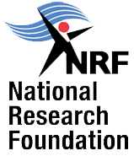
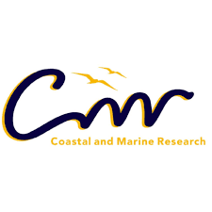
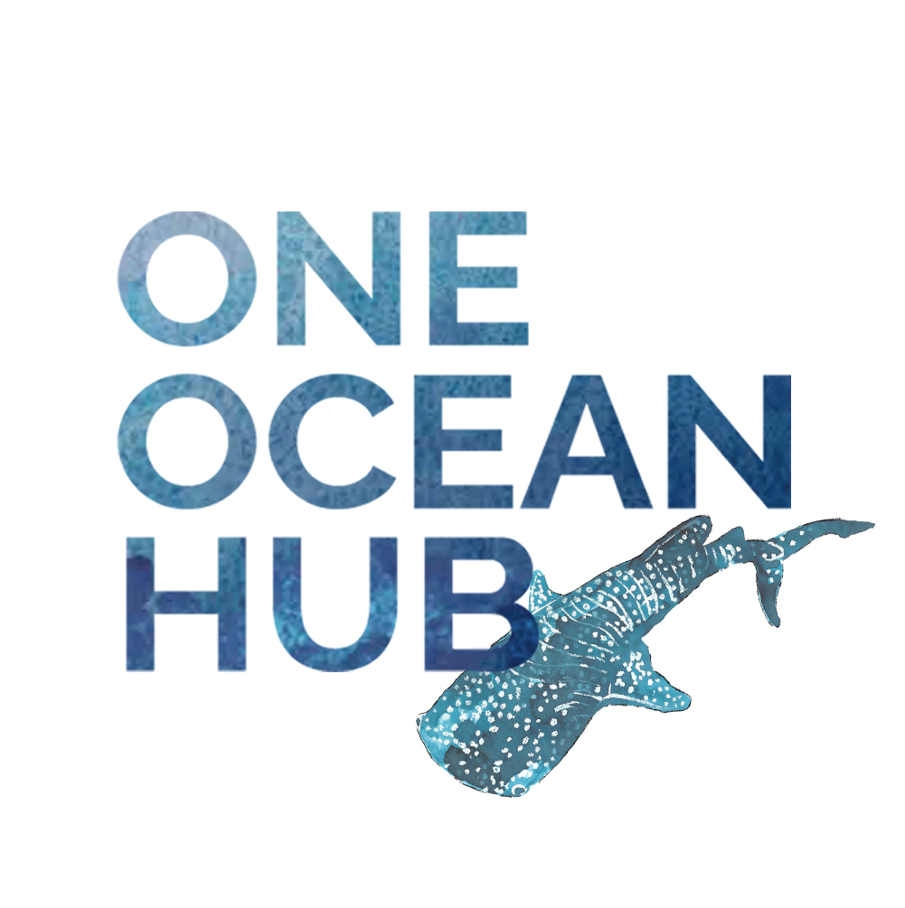
HAZARDOUS HERITAGE: THE SOCIAL LIFE OF PLASTICS
Prof Rose Boswell
DSI-NRF SARCHI Chair
OCEAN CULTURES AND HERITAGE
Nelson Mandela University
8 September 2021

Slide 2
The ethnography presented in the paper seeks to shift perspective on marine pollution by emphasising behavioural and gendered practices exacerbating plastic and ultimately marine pollution.
It is proposed that plastic use is tightly aligned to specific notions of sociality, equality and modernity and that alleviation of the marine pollution crisis therefore must depend on deep engagement on social and bodily practices in South Africa. In many ways, plastics form part of the country’s ‘biocultural’ heritage.
The presentation also covers discussion on anthropology and advocacy, and the relevance of interdisciplinarity within the humanities

Slide 3
Natural science data shows:
…. Plastic debris also has an afﬁnity for certain non-essential trace elements and persistent organic pollutants (POPs), such as polychlorinated biphenyls (PCBs) and dichlorodiphenyltrichloroethane (DDT)… Once plastics are discharged into aquatic environments, they can persist for up to 50 years, and their complete mineralization may take hundreds or thousands of years (Holland, Mallory and Shutler 2016: 252)
…(in various species we note) ‘…reproductive impairment, neurotoxicity, biotransformation of enzymes, genotoxicity, physical effects, behavioural effects, oxidative stress and damage, cytotoxicity, blood/haemolymph effects and increased accumulation of other contaminants’ (de Sà, Oliviera, Ribeiro, Lopes Rocha and Futter 2018:the proliferation of plastic bag garbage in the environment poses health risks to cattle, sheep, and other livestock who ingest plastic bags littered in the streets and may die as a result of the obstruction of their digestive systems. (Braun and Taore 2016:824) 1031).

Slide 4
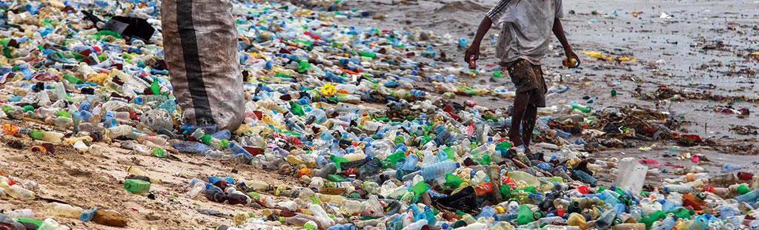
‘In South Africa, only 16% of plastic is recycled. The rest of the plastic ends up at landfill locations where they can end up in rivers (due to wind, littering, inproper waste management, overflowing landfills) and eventually end up in the ocean. Sadly 8 million metric tons of discarded plastic end up in the ocean’ (Hankel and Burgess, CSIR).
‘The problem is exacerbated by the growing middle class in Africa, creating large markets for consumer plastic goods and packaging.’

Slide 5
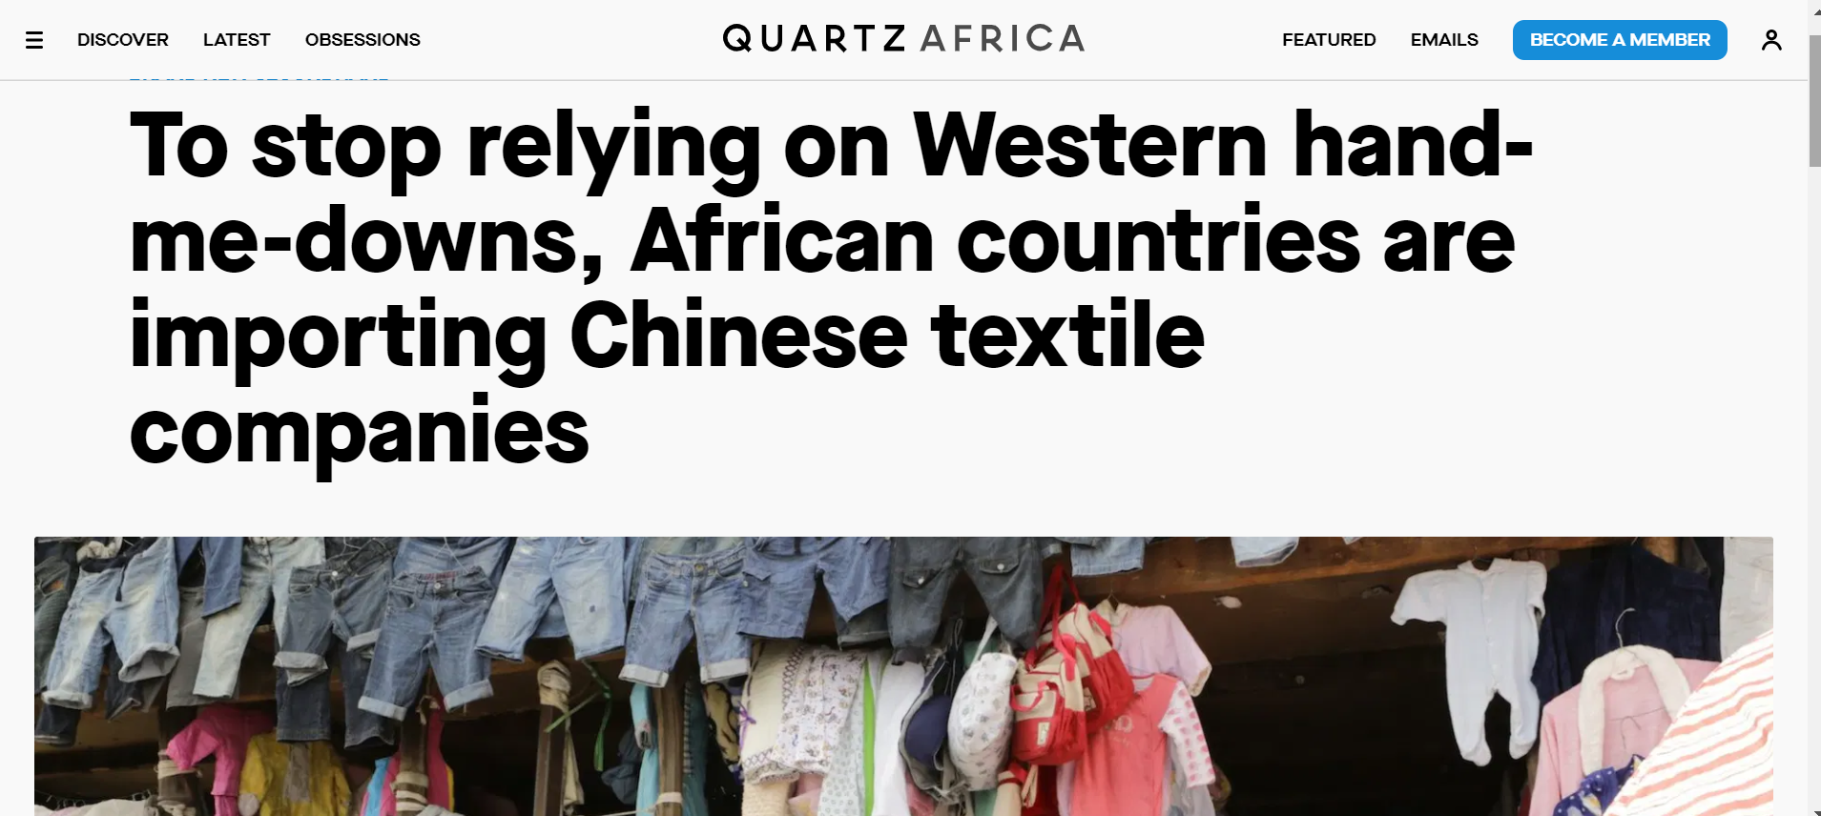
Government focuses on upstream factors

Slide 6
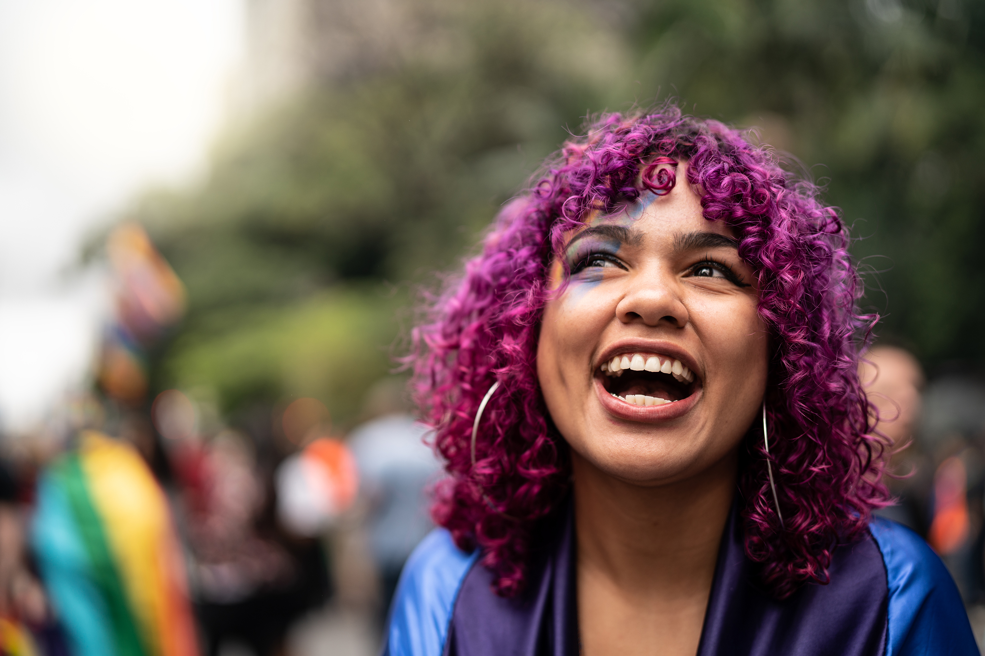
The problem of plastic consumption is also highly politicised and gendered.

Slide 7
The Ethnographic Observations

Slide 8
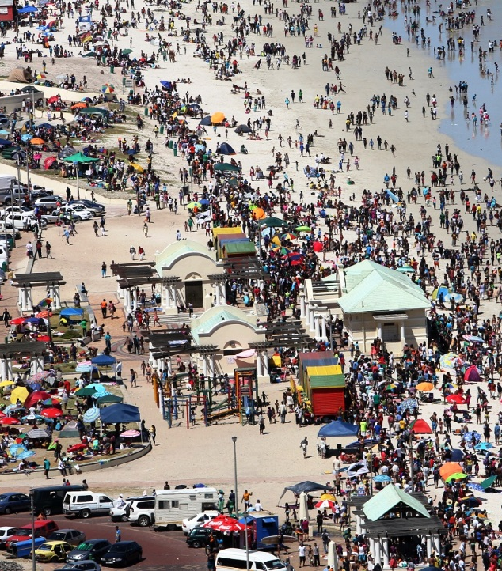
Durban beach in December 2020

Slide 9
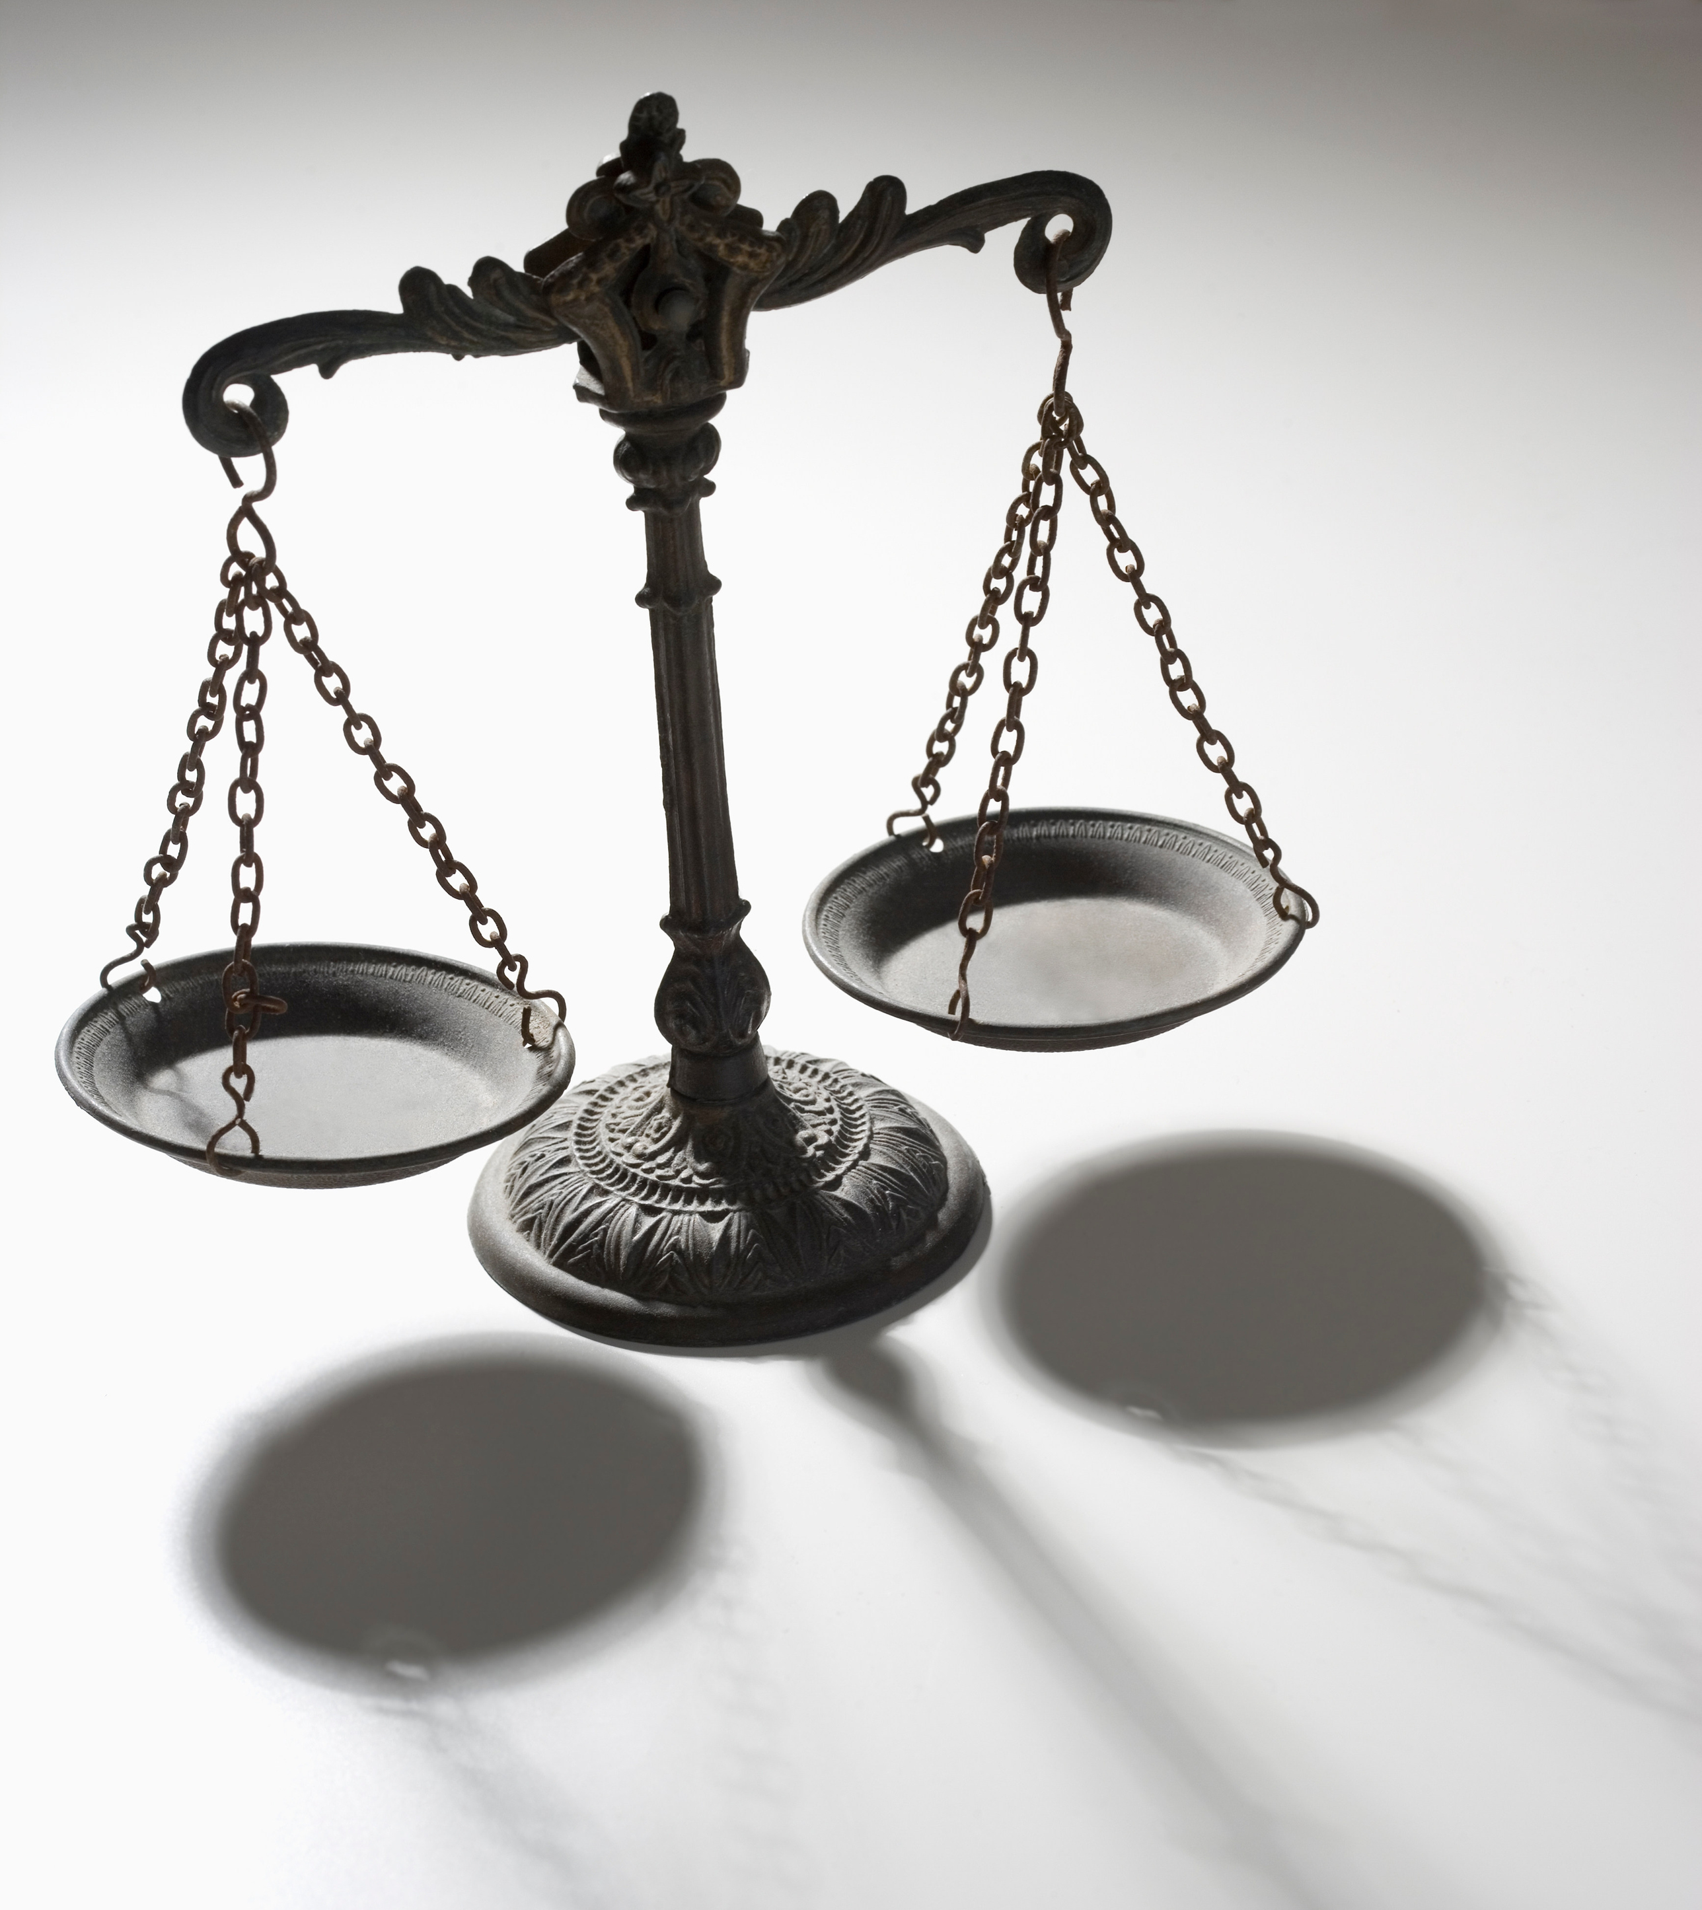
Legal loopholes
Anthropology and sociology of advocacy requires us to analyse legal frameworks, rights, responsibilities and duties in the social space.
In the context of ocean management, it requires attention to issues of coastal justice and ocean rights.
The Integrated Coastal Management Act (ICM) 2008, appears to refer only to the inclusion of previously (racially) marginalised communities in coastal management efforts and plans.
The National Environmental Management: Waste Act 59 of 2008, mentions littering as an offence, but does not note use and eventual legal (but still hazardous) disposal of plastic, as part of waste management.
The South Africa’s Marine Pollution Act, no. 2 of 1986 (amended Bill of 2019) only refers to marine and coastal pollution as caused by ships.
Question: Are South Africa’s environmental laws focused on the rights of citizens? What about individual responsibilities?

Slide 10
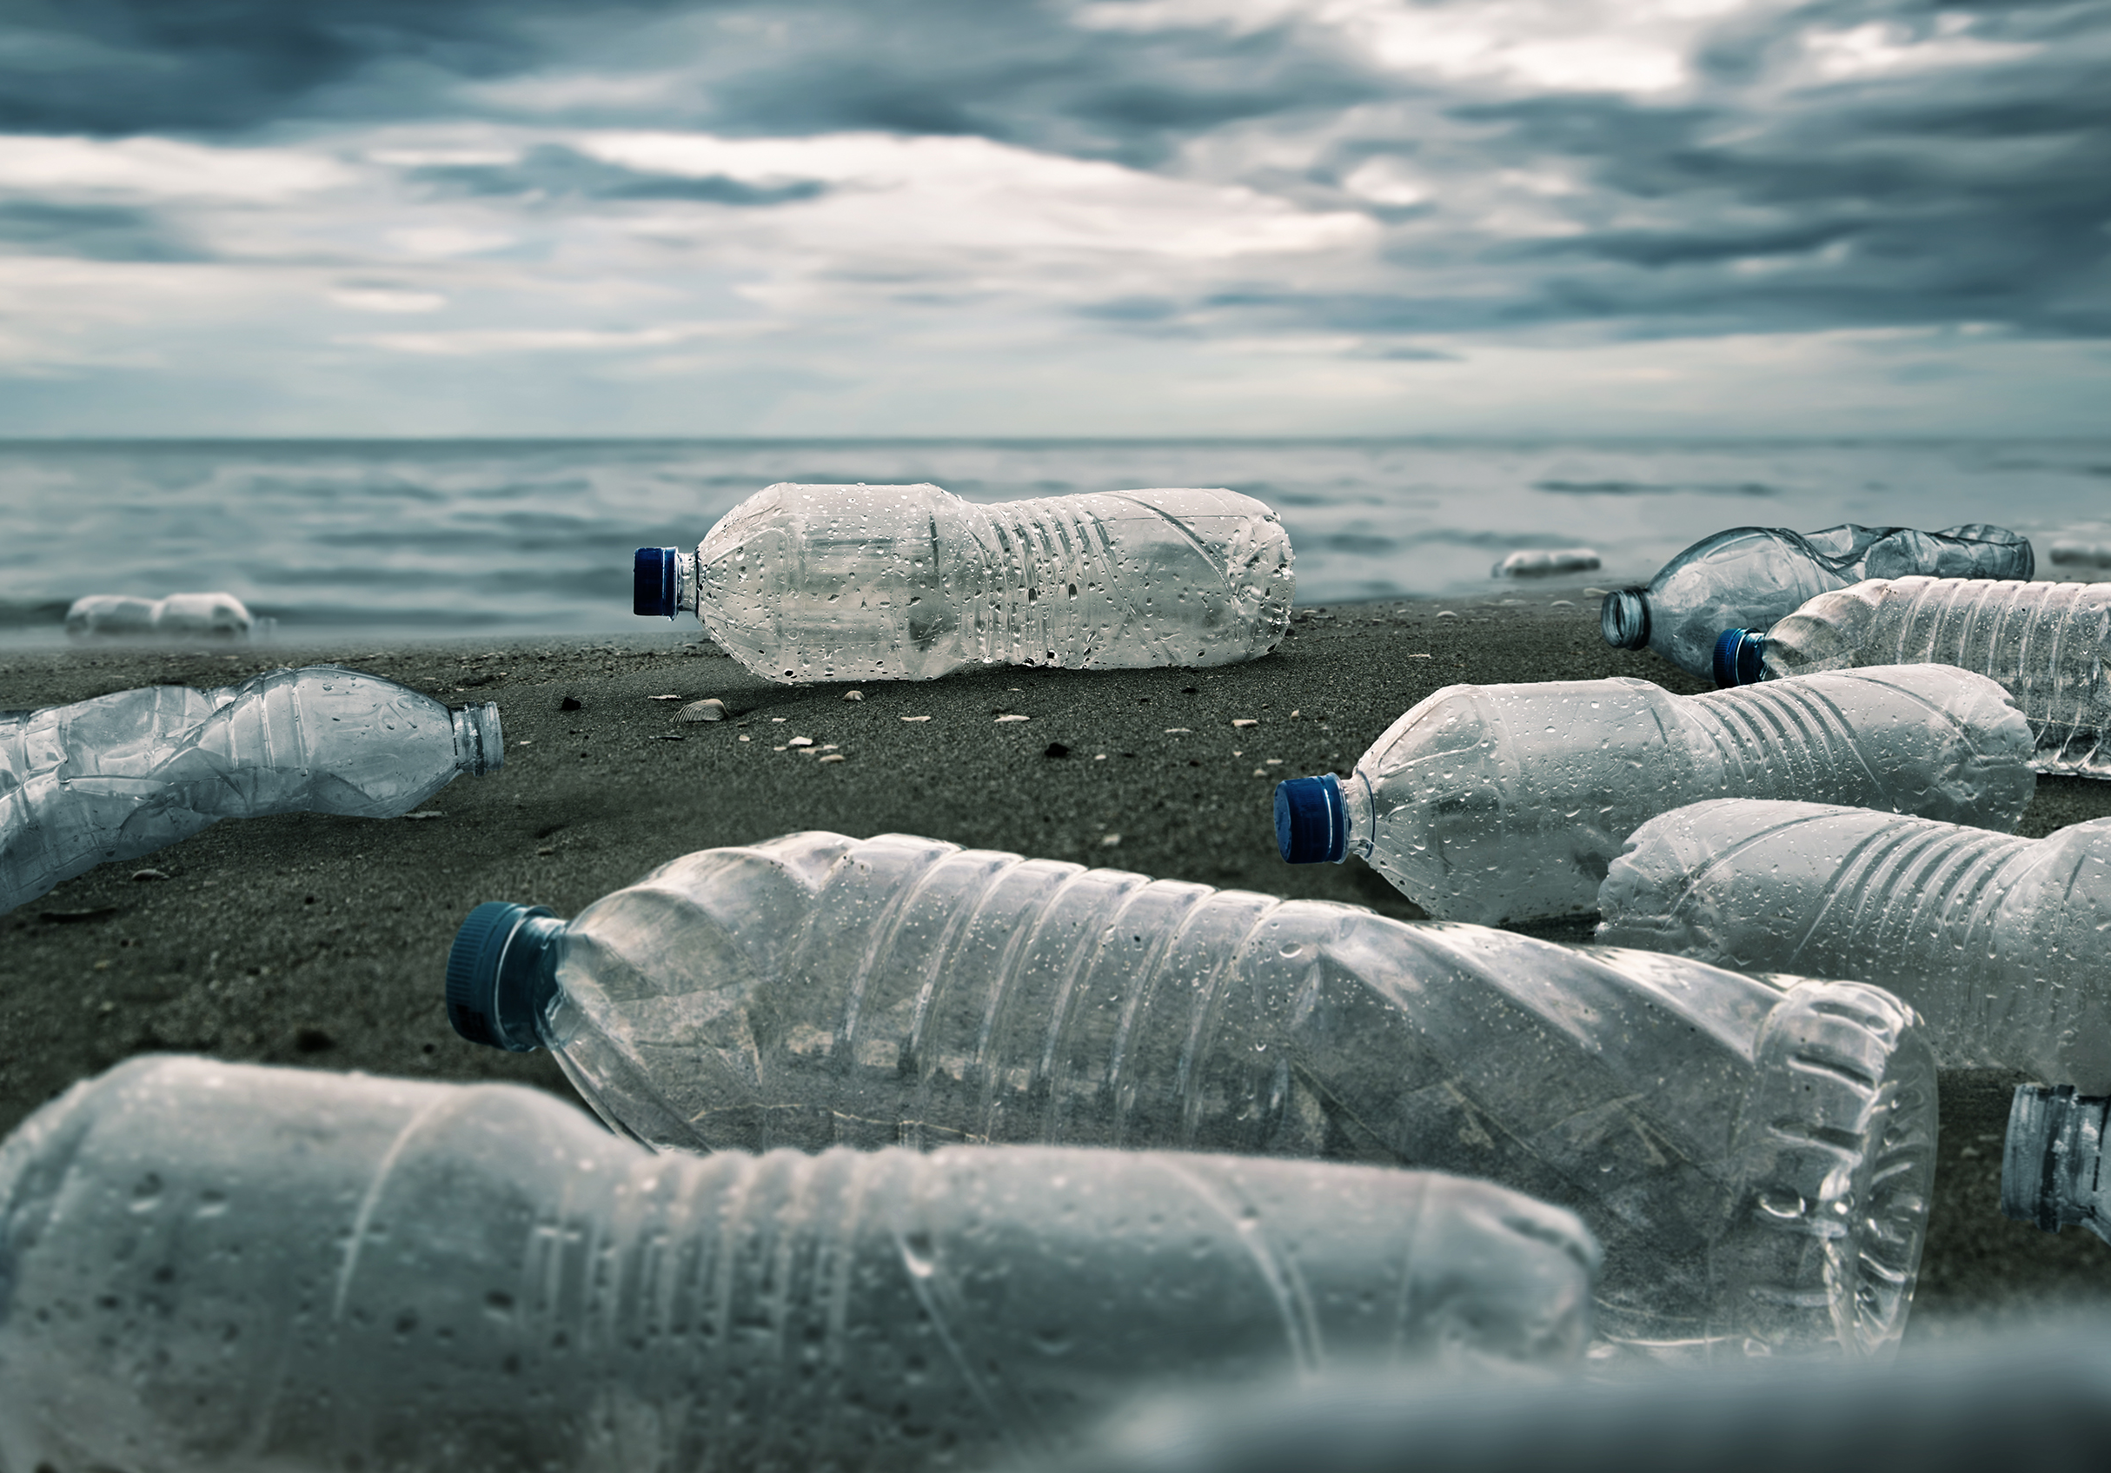
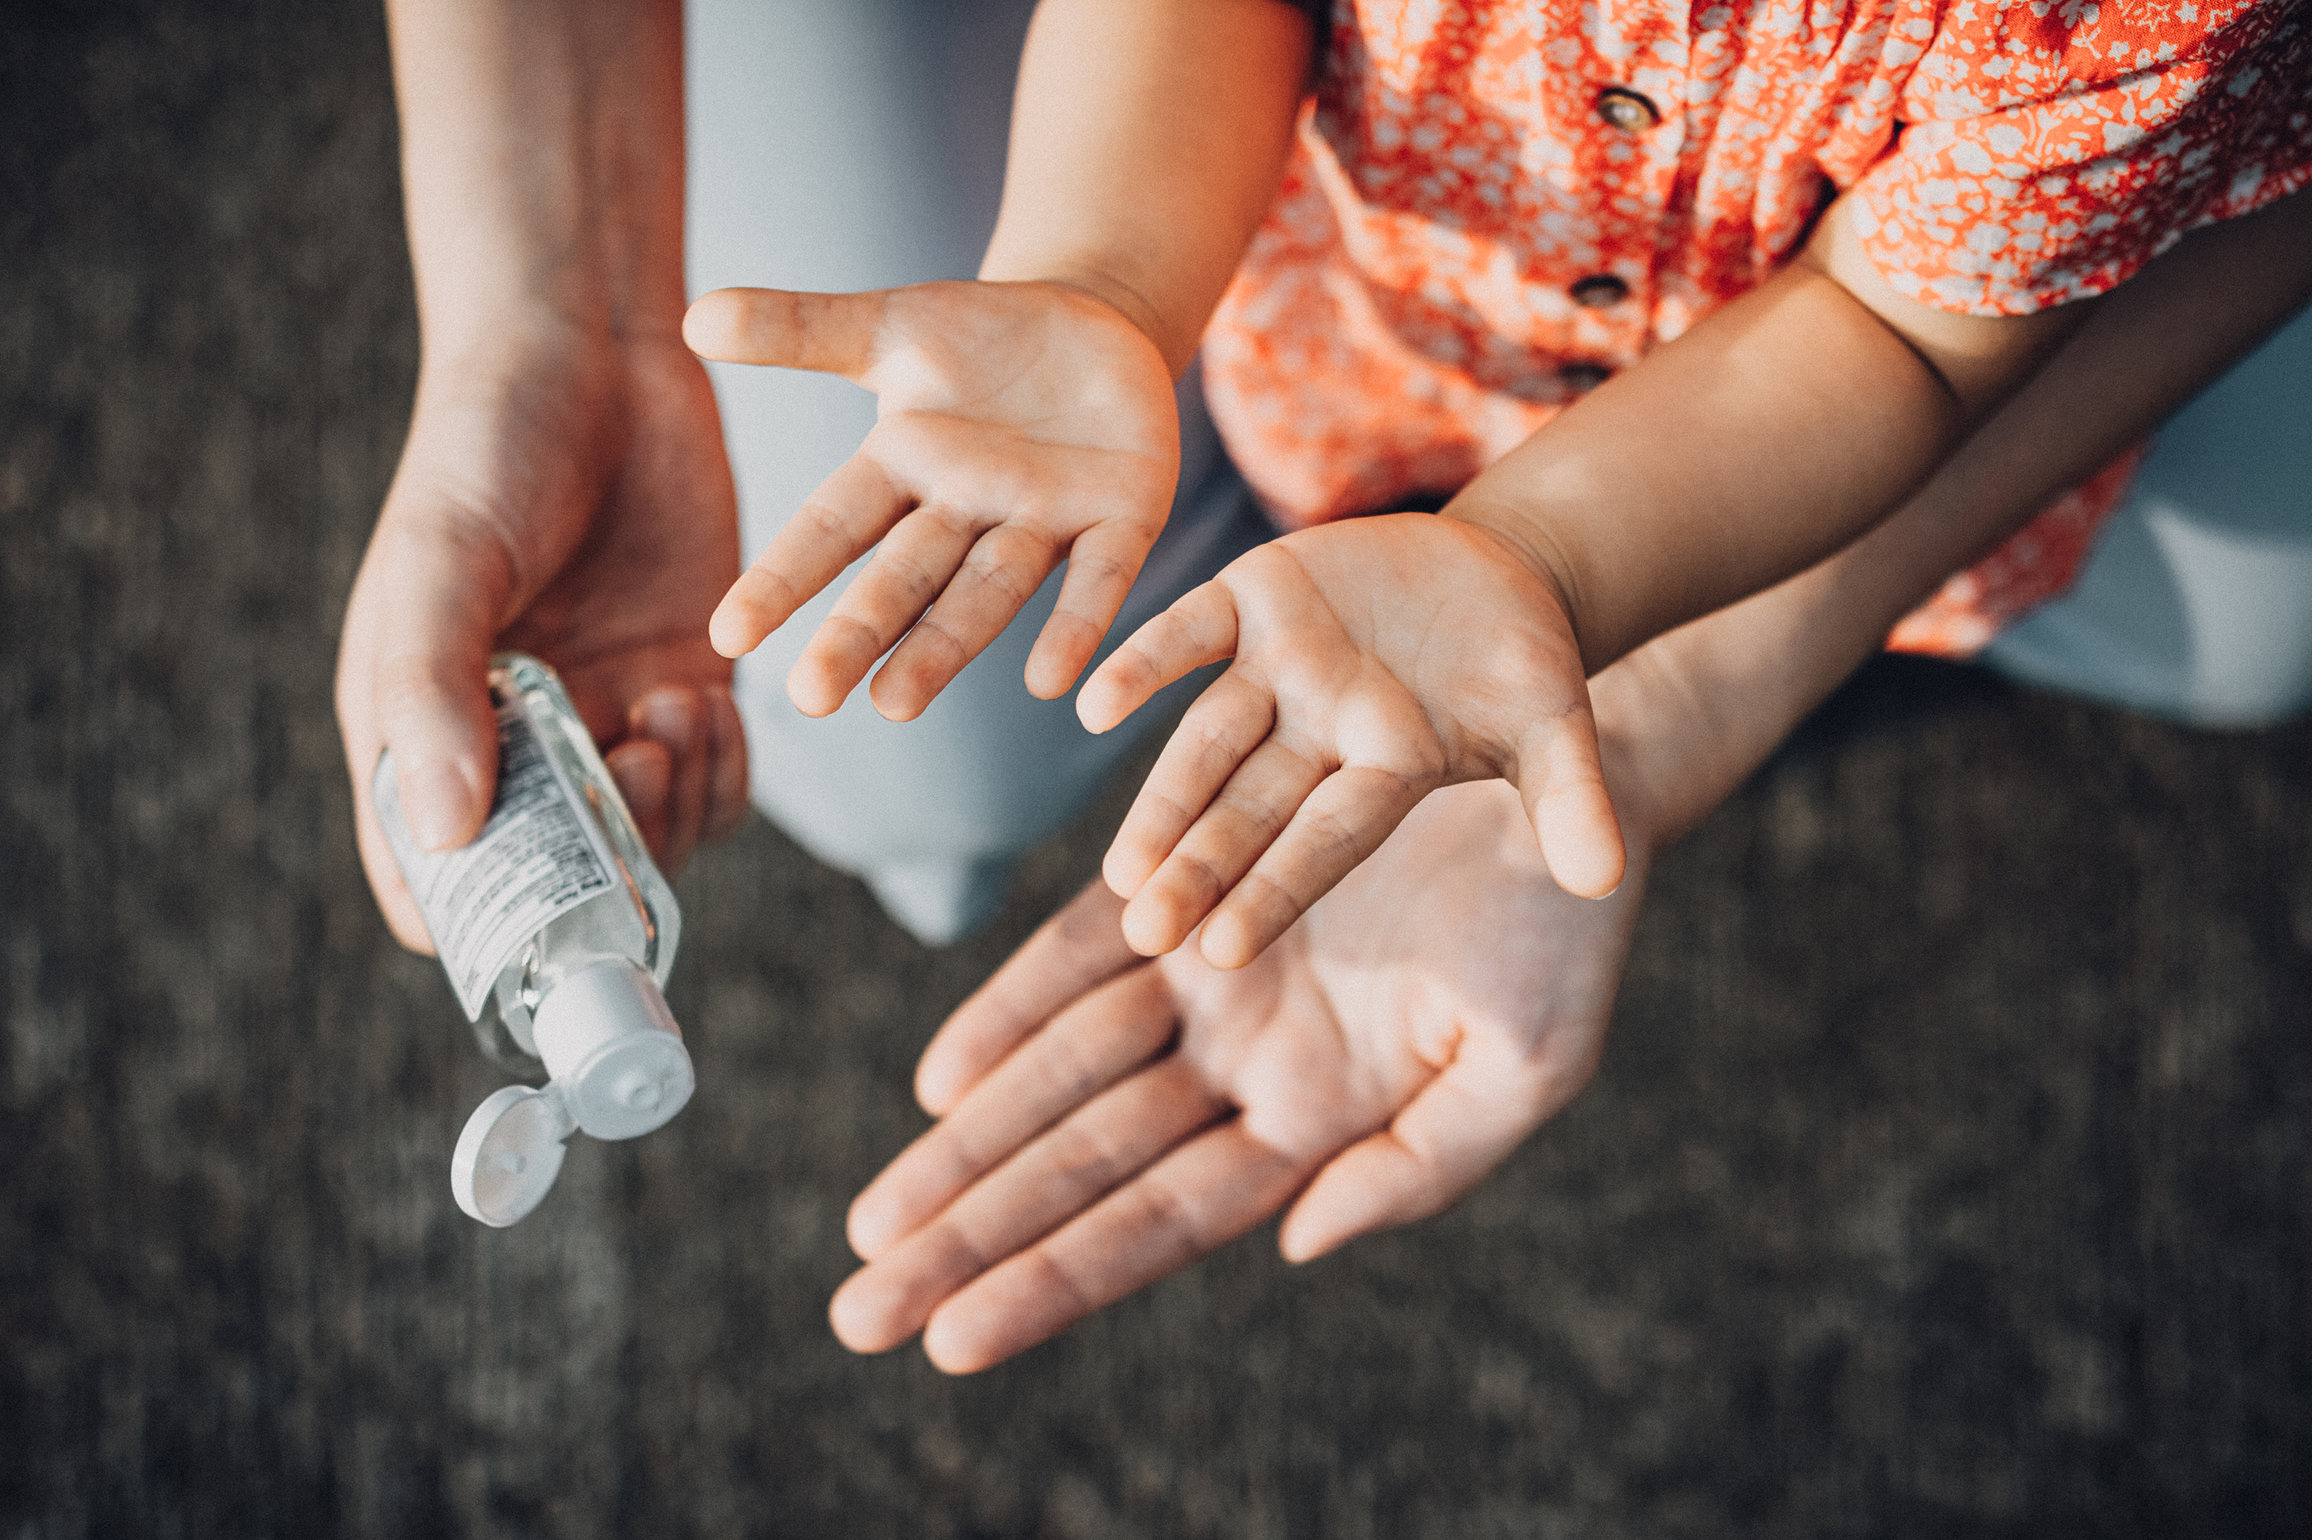
conclusions

