Slide 1
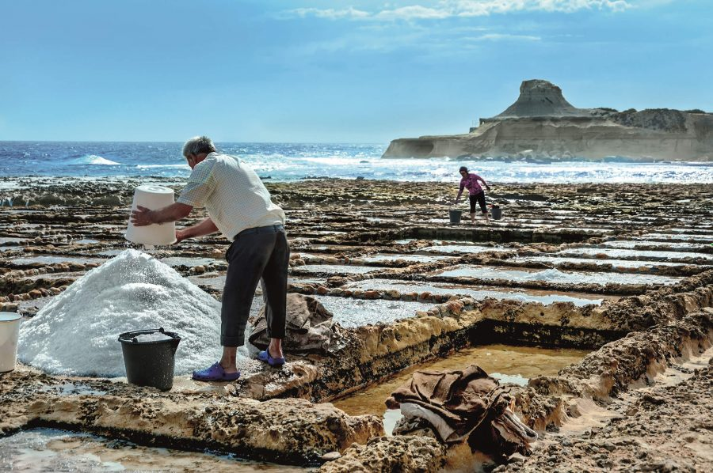
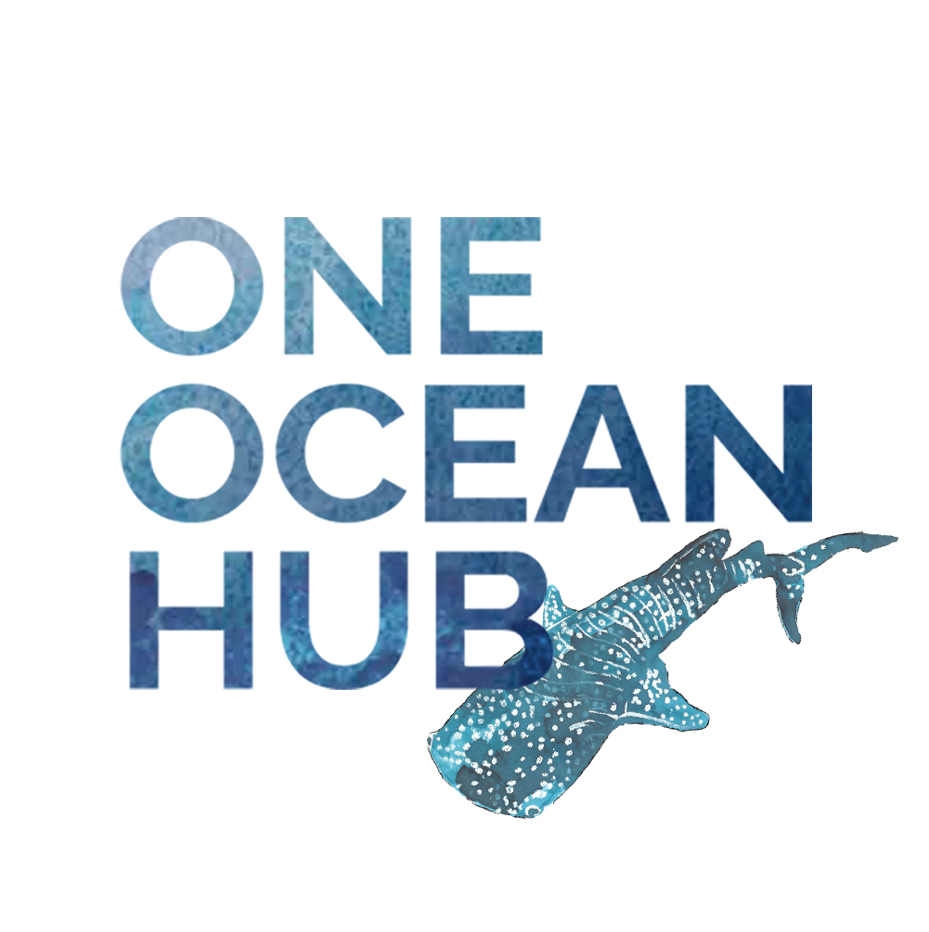
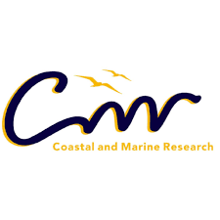
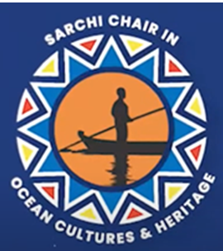
SALTED IDENTITIES?
BIOCULTURAL HERITAGE FOR A REHUMANISED OCEAN CONSERVATION
By Prof Rose Boswell (PhD Anthropology)
SARCHI Chair Ocean Cultures and Heritage, Nelson Mandela University, South Africa.
15 September 2021

Slide 2
It is said that before entering the sea a river trembles with fear. She looks back at the path she has traveled, from the peaks of the mountains, the long winding road crossing forests and villages. And in front of her, she sees an ocean so vast, that to enter there seems nothing more than to disappear forever. But there is no other way. The river can not go back. Nobody can go back. To go back is impossible in existence. The river needs to take the risk of entering the ocean because only then will fear disappear, because that’s where the river will know it’s not about disappearing into the ocean, but of becoming the ocean.
Khalil Gibran. The River Cannot go Back

Slide 3
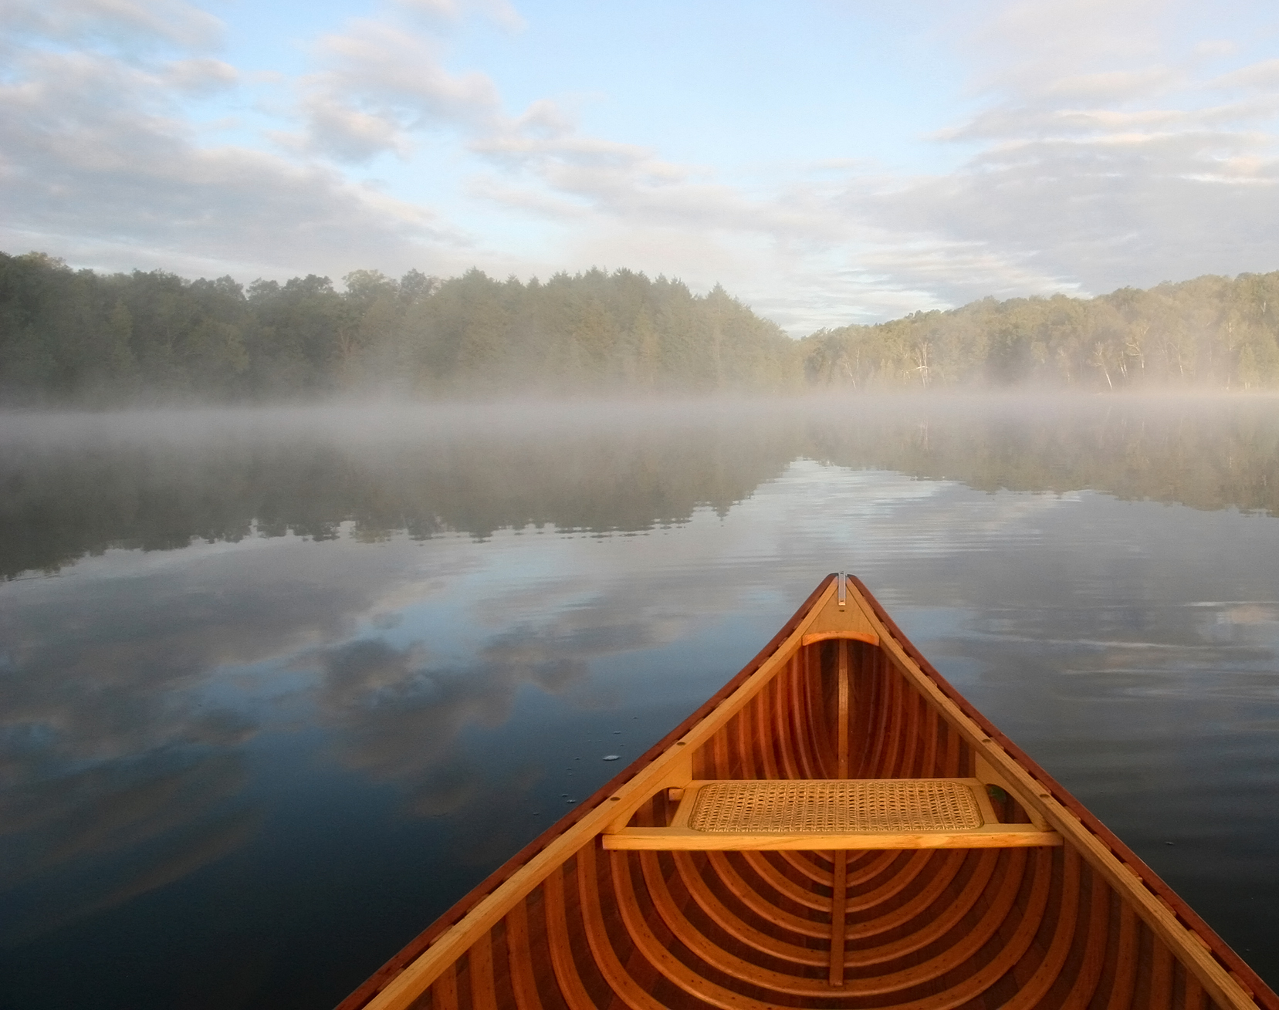
Inspiration, currents and vessels

Slide 4
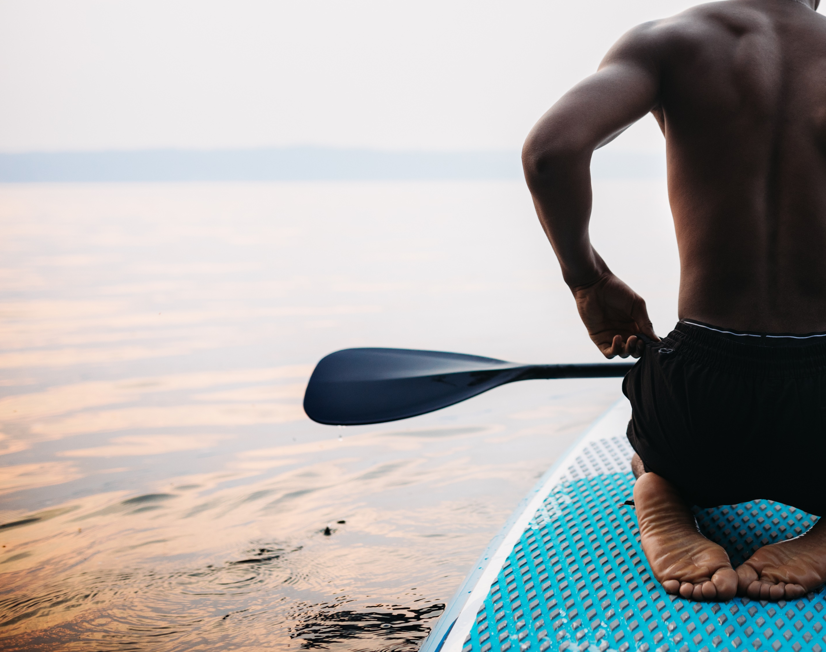
Heritage, biocultural relations and trauma
Heritage in Africa and South Africa – basic points
The distinctions between forms of heritage
Global coastal communities articulate their heritages of the sea
Forced removals and coastal trauma.
Why we need more state and scholarly attention on the situated and embodied nature of coastal personhood, as well as human biological connection to nature.
Challenging compartmentalised thinking regarding ocean management

Slide 5
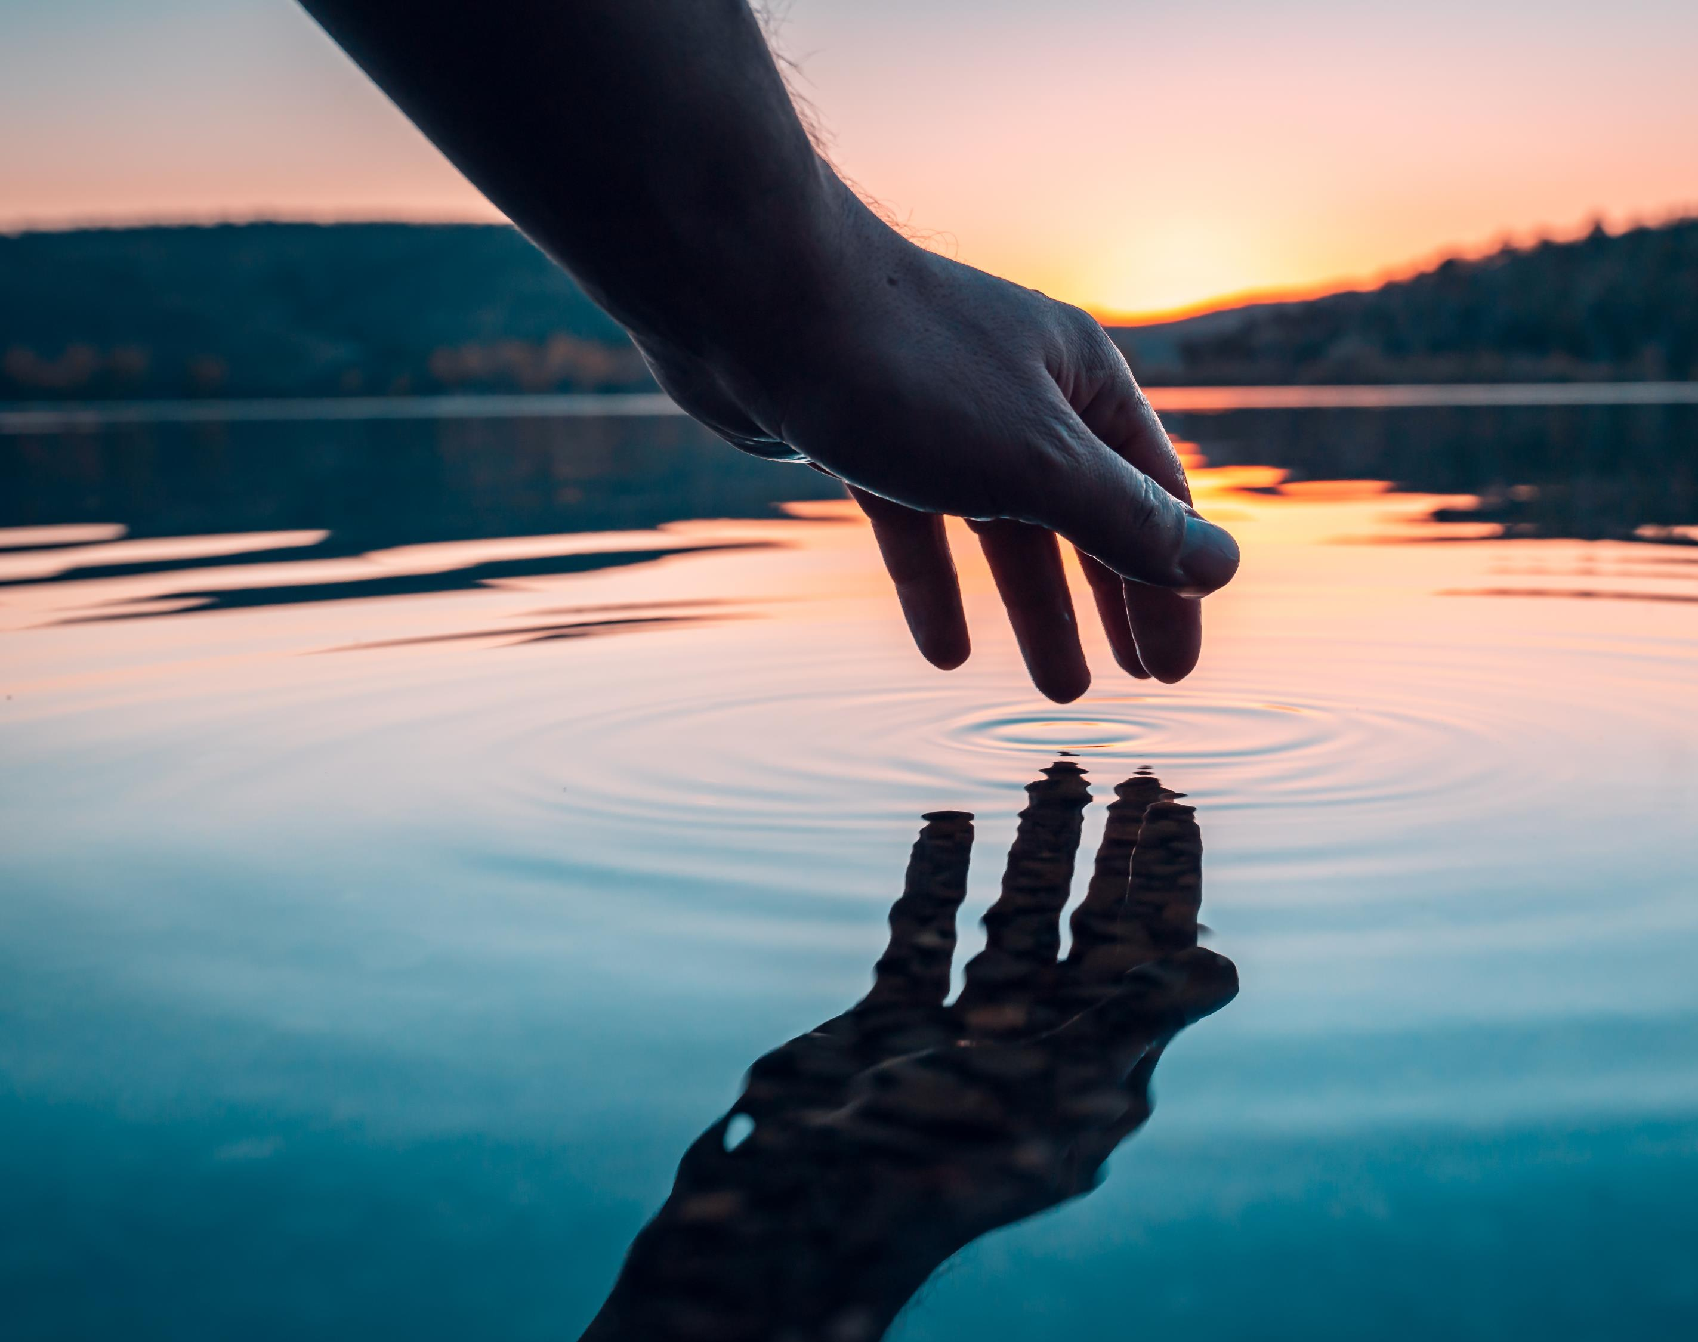
Biocultural Heritage
Khongsdier’s (2015) definition of the biocultural approach
Scholarship on indigenes and bio and sociocultural diversity state that denying human social and biological embedding in particular locales is exclusionary and potentially genocidal.
Ekblom et al (2019) on nature embedded memories – ecosystem memories, landscape memories, place memories and stewardship. A bit rigid?
Ethnography presented here shows interactions with the sea reveal biocultural identity that is diversely located –memory and spirit, body, senses (hearing, taste, smell, touch), generation, ethnicity – suggesting a holistic and symbiotic experience of nature

Slide 6
Globalised references to biocultural connection, salt is a major feature
You are the salt of the earth, but if the salt has lost its flavor, with what will it be salted? It is then good for nothing, but to be cast out and trodden under the feet of men.
— Matthew 5:13
"Let there be work, bread, water and salt for all." ~ Nelson Mandela
Now and then, when I grow nostalgic about my ocean childhood - the wauling of gulls and the smell of salt, somebody solicitous will bundle me into a car and drive me to the nearest briny horizon. Sylvia Plath
With every drop of water you drink, every breath you take, you're connected to the sea. No matter where on Earth you live. Most of the oxygen in the atmosphere is generated by the sea.
Sylvia Earle

Slide 7
Multiple idiomatic expressions regarding salt and the sea --- and of human relations with both

Slide 8
History, biology, geology, Anthropology
Archaeology: from the earliest times that humans have relied on nature for sustenance, entertainment, healing and many other self-constituting processes. The relationship between humans and nature appears in history, to be profoundly symbiotic.
Geology: ‘the importance of geologic materials, particularly minerals, as healing agents has been recognized since antiquity. Ancient Chinese and Indian people used minerals for healing as far back as 3000 BC.’ (Hasan 2021: 686). This included salt.
Medical Geology: Salt as one of 11 essential elements for human survival. Salt is in tears, amniotic fluid, necessary for electrolyte balance and blood pressure but people also had to find freshwater that was not briny – stromatolites as sources.
Anthropology: leads us to consider the intersubjectivity, mutuality, interdependency of humans, animals and seemingly inanimate objects – to critique a view of humans as separate from nature and omnipresent in all circumstances. This is also encouraging post-human, multispecies perspectives, and ‘now’, biocultural views of existence.
These views are critical in a society where identity has been ‘straightjacketed’ – and where various oppressions, including epistemological oppressions, continue
salt
Biology
Geology
culture
Archaeo

Slide 9
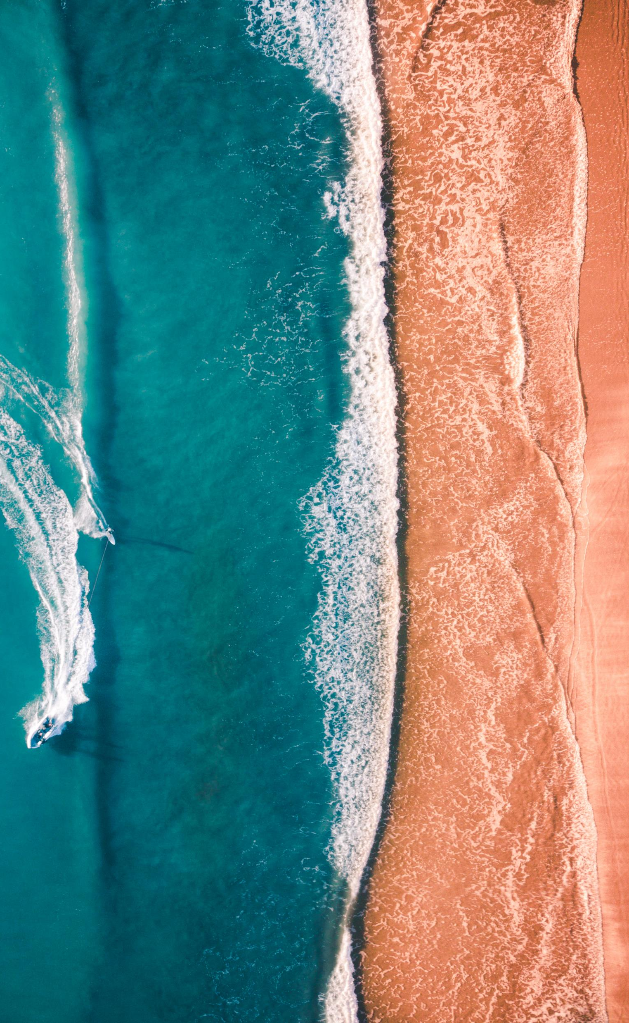
Mineralized and de-Mineralized Identity
Some further scholarship on personhood, biological connections with nature and trauma.
The ethnographic findings:
Research in Tsitsikamma revealed that those with an enduring relationship with the sea, believe that they become mineralized (salted) in their interaction with sea and coast, a situation which they say produces a feeling of wellbeing despite the experience of objective hardship. Today, their de-mineralisation (loss of saltiness) is expressed as both a metaphor for, and form of trauma including depression.
During apartheid, the concept and transfer of land was ‘textualised’, as were social relations.
People speak of hearing the sea for healing, being in the sea, imbibing the sea. Salt comes up in the conversations – emphasising the need to reconstitute the self with the briny sea.
Examples from Mauritius, Zanzibar, Ghana, Seychelles etc.

Slide 10
Voices in South Africa
I did not believe it until I discovered it.
You’re drinking this litre to clean your stomach. The ocean cleanses you and many days…You have ride over the water (referring to illness), so the sea spits you out again and it doesn’t spit you out where you fell, it spits you out in a different place. But when it comes to sicknesses, you can drink the water to clean yourself on the inside. You don’t have to go to town, just fetch a litre of water and drink it and then you’re cleaning your body on the inside and then you’re fresh, like a human being.
Oh brother, let me tell you something. If I just feel that breeze in the morning, that inhalation, then you feel human. If I’ve had a drink at night and go swimming the next morning, then I’m like a fresh buck that jumps all day. I always told my father when he was alive, my sick dad, “daddy take me to the beach.”

Slide 11
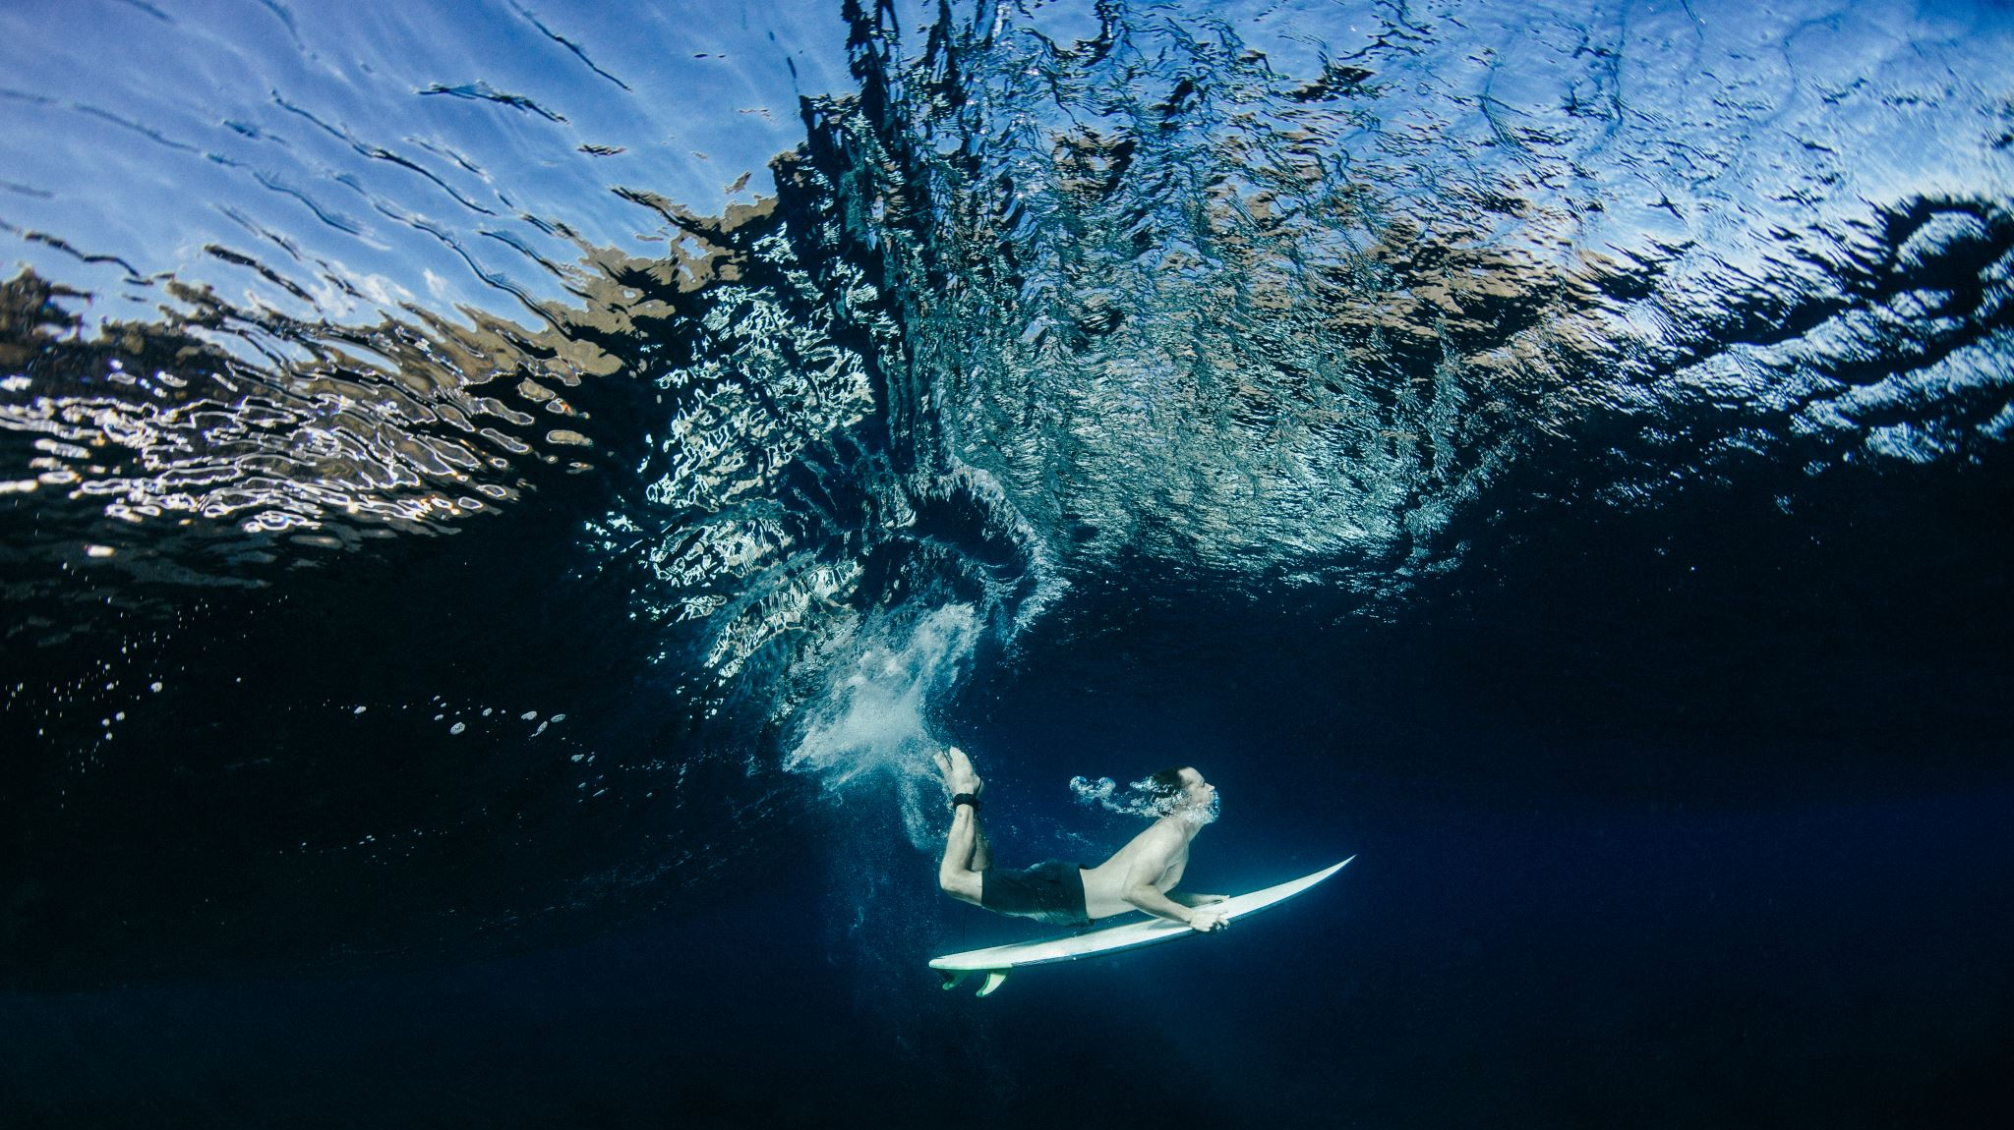
conclusion

